Slide 1

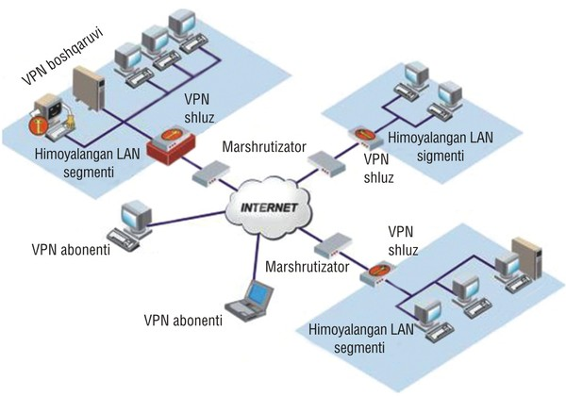
TARMOQ ADMINISTRATORLIGI 6-DARS

Slide 2


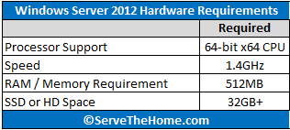
WINDOWS SERVER 2012 R2

Slide 3
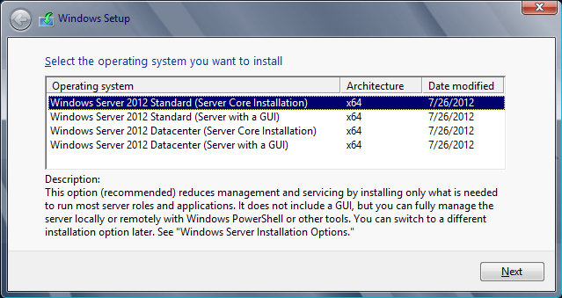
WINDOWS SERVER 2012 R2

Slide 4
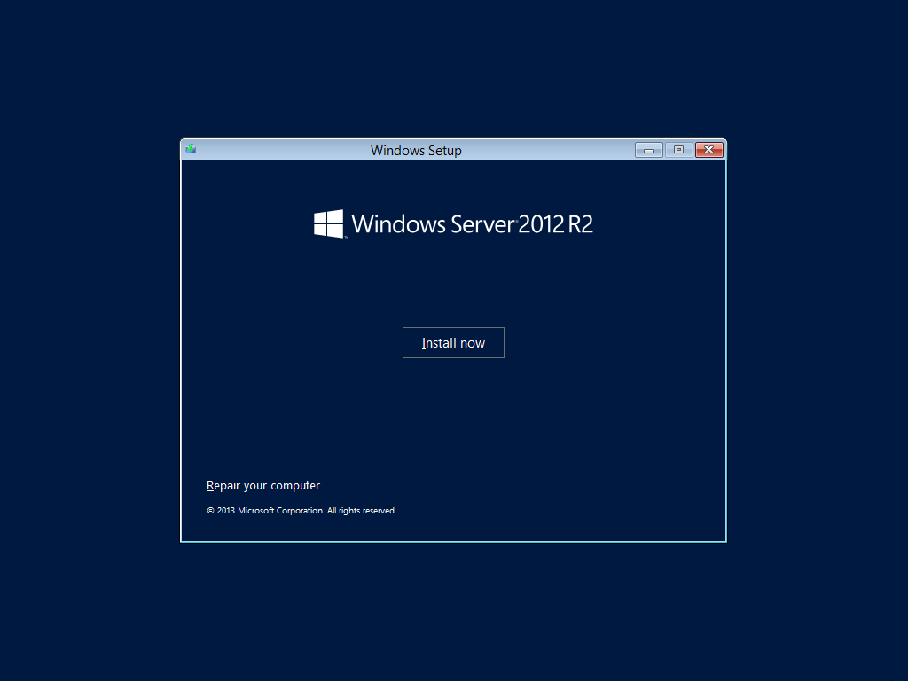
WINDOWS SERVER 2012 R2

Slide 5
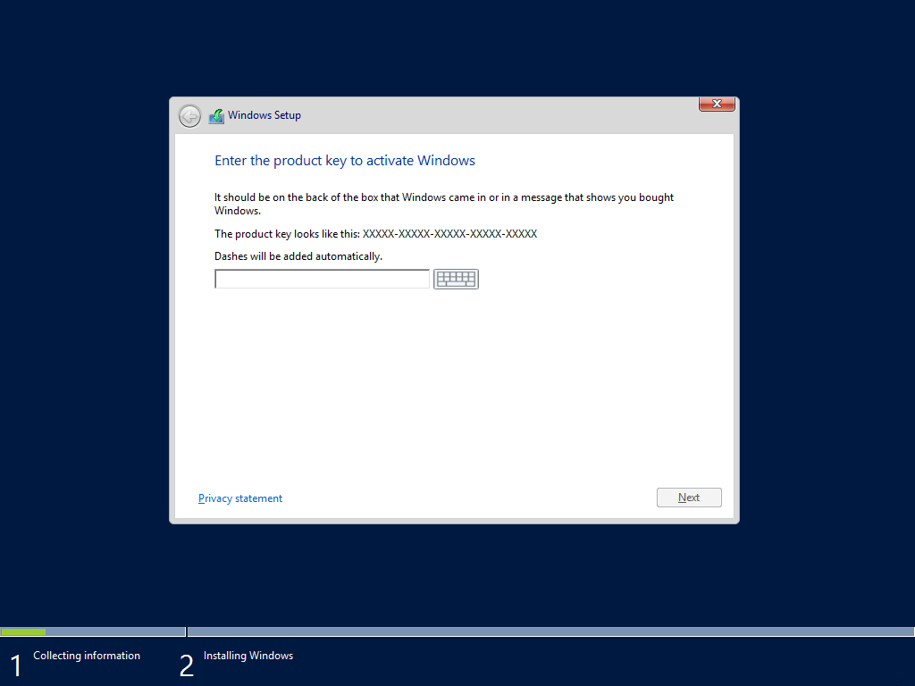
WINDOWS SERVER 2012 R2

Slide 6
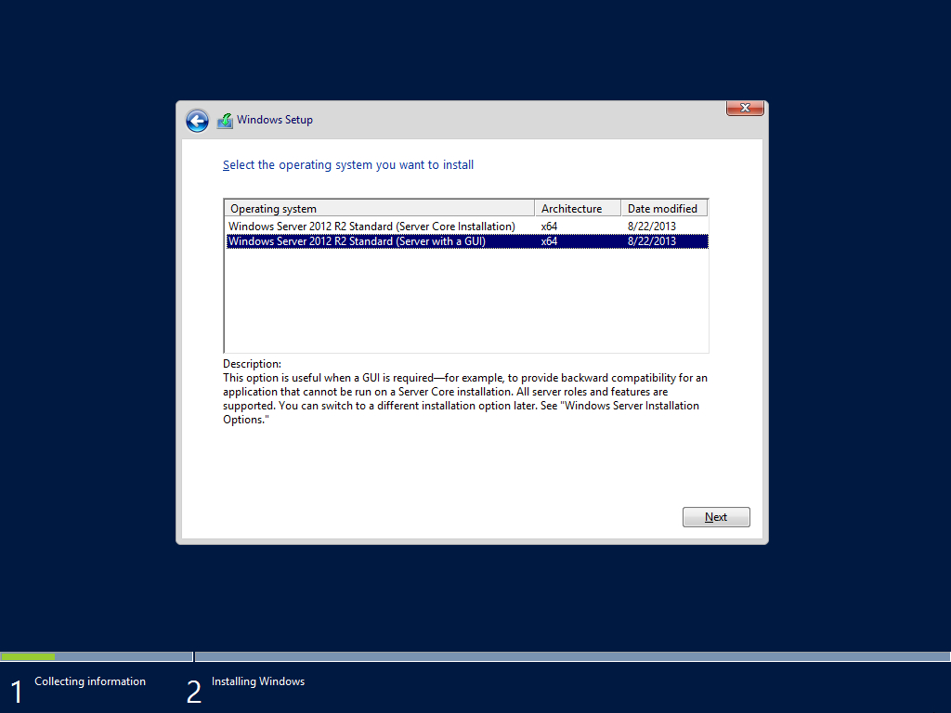
WINDOWS SERVER 2012 R2

Slide 7
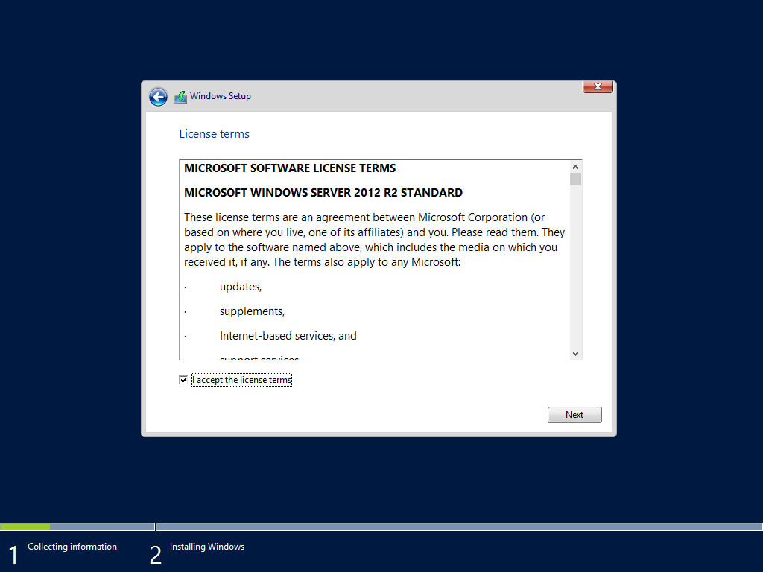
WINDOWS SERVER 2012 R2

Slide 8
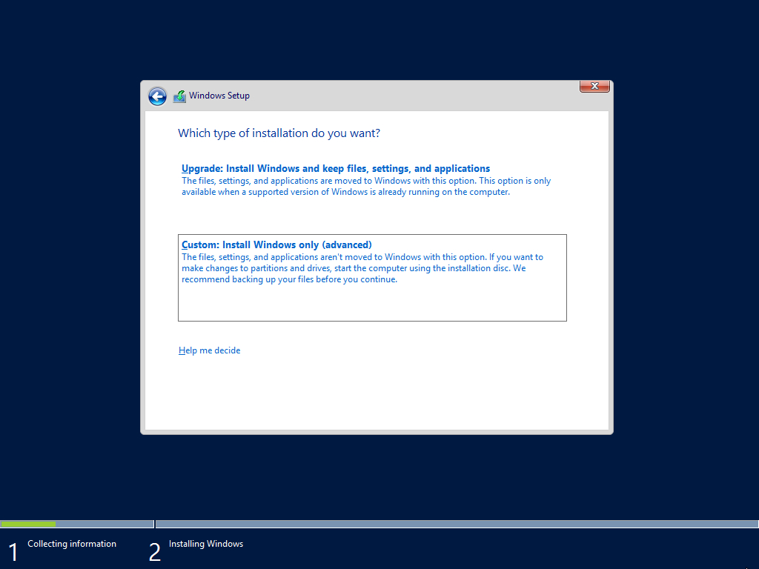
WINDOWS SERVER 2012 R2

Slide 9
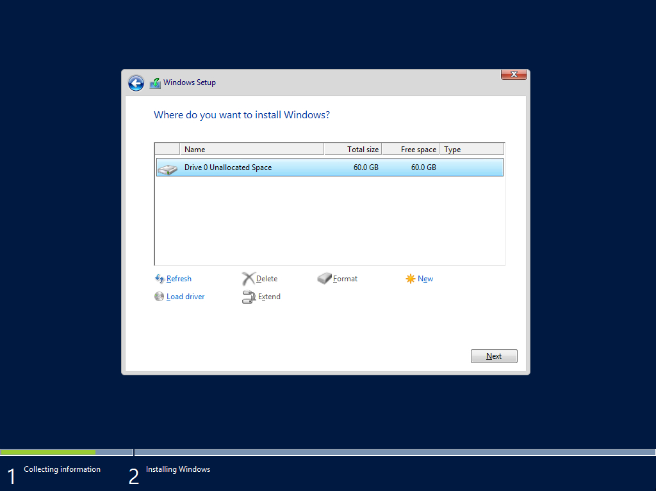
WINDOWS SERVER 2012 R2

Slide 10
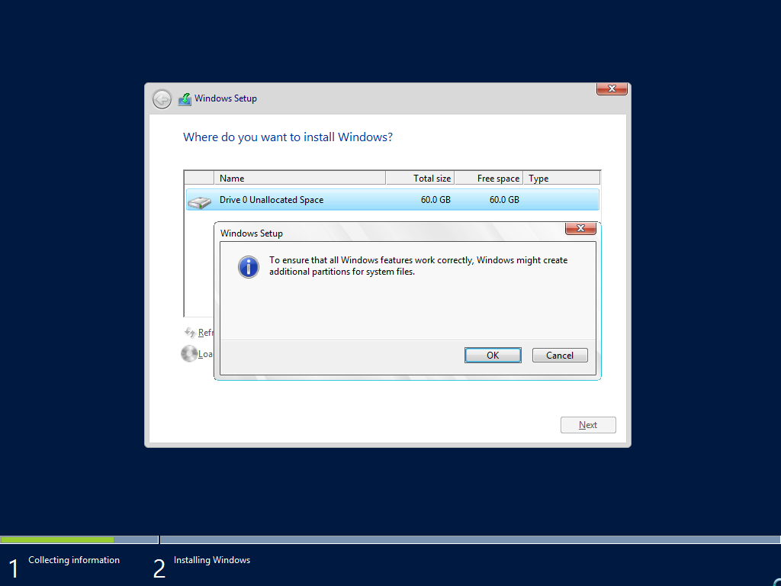
WINDOWS SERVER 2012 R2

Slide 11

WINDOWS SERVER 2012 R2

Slide 12
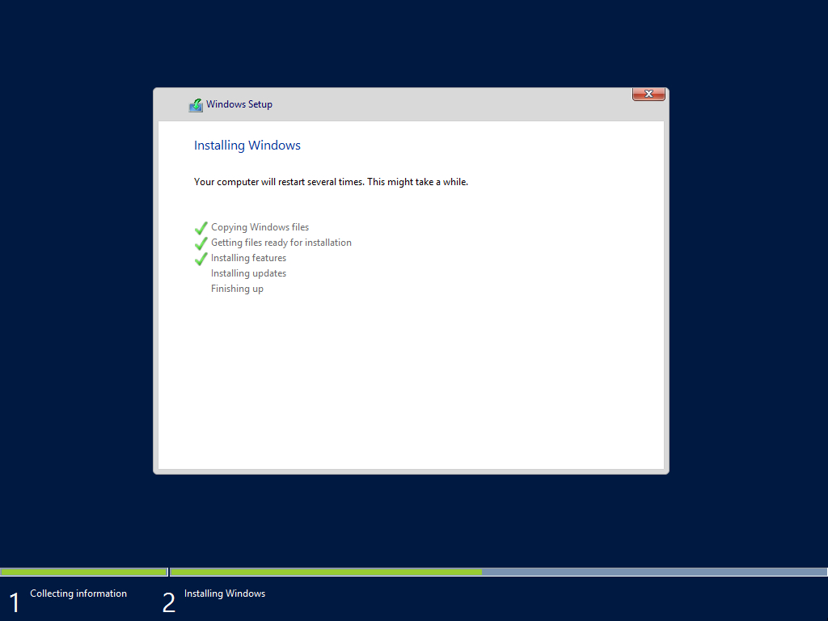
WINDOWS SERVER 2012 R2

Slide 13
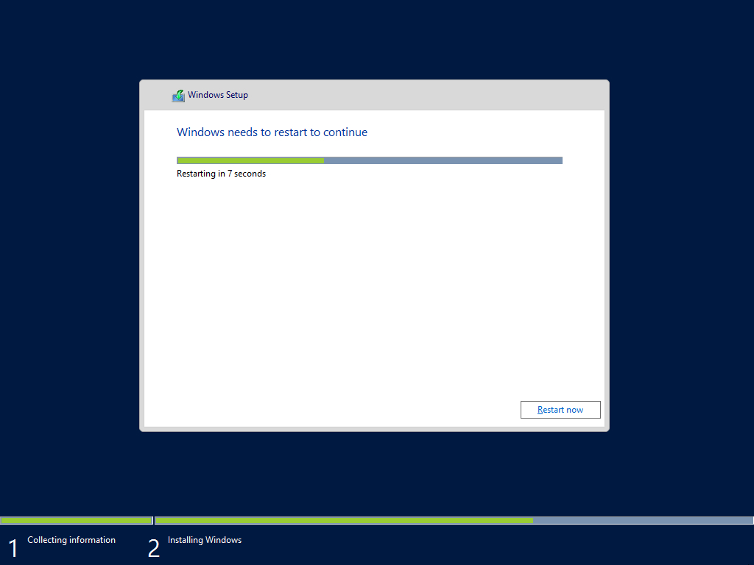
WINDOWS SERVER 2012 R2

Slide 14
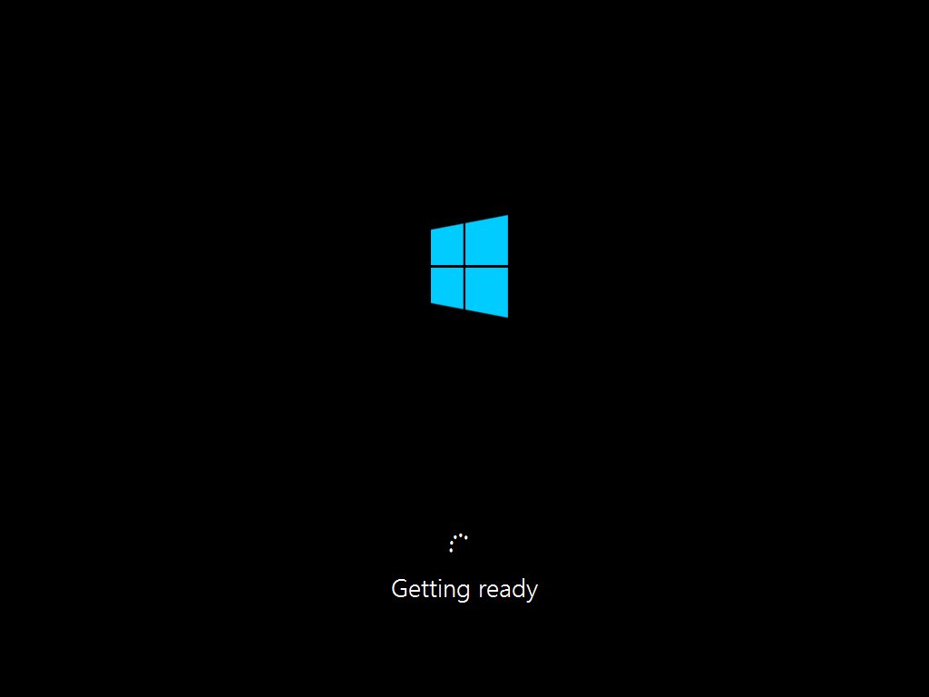
WINDOWS SERVER 2012 R2

Slide 15
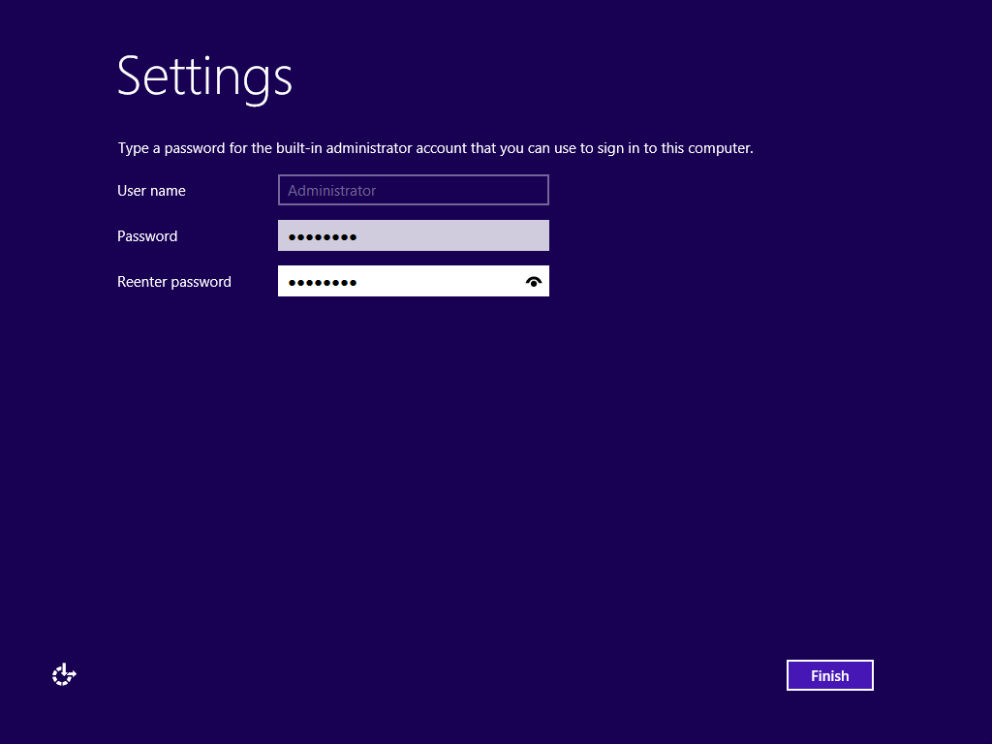
WINDOWS SERVER 2012 R2

Slide 16
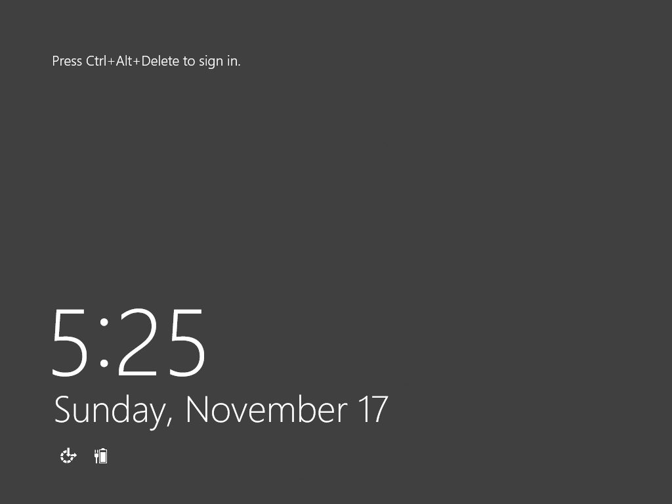
WINDOWS SERVER 2012 R2

Slide 17
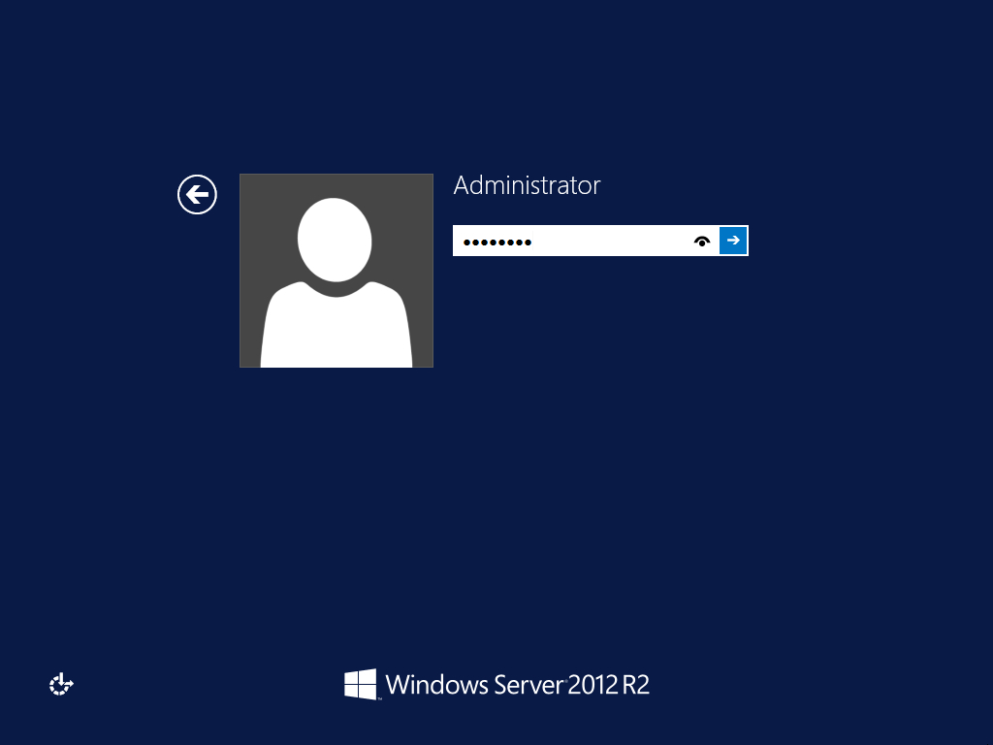
WINDOWS SERVER 2012 R2

Slide 18
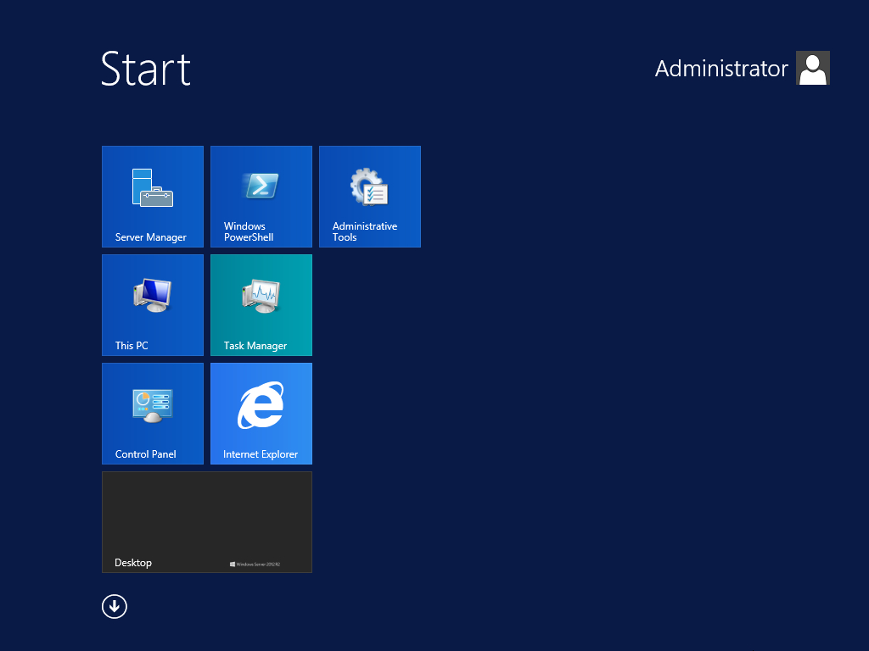
WINDOWS SERVER 2012 R2

Slide 19
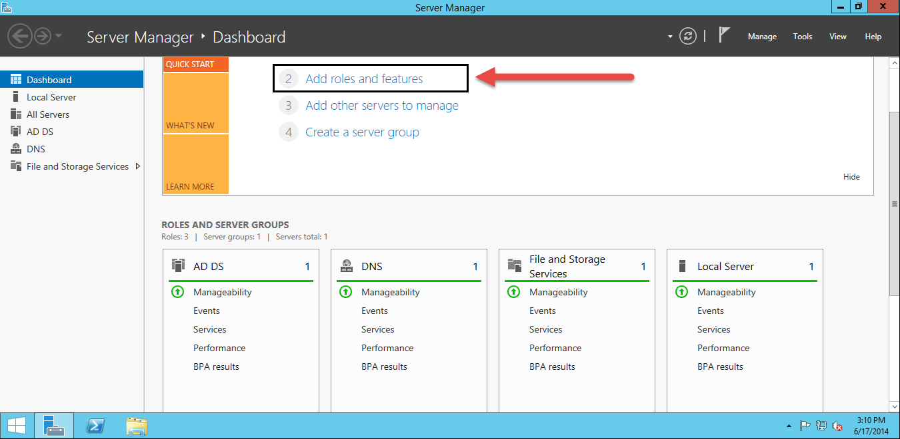
WINDOWS SERVER 2012 R2

Slide 20
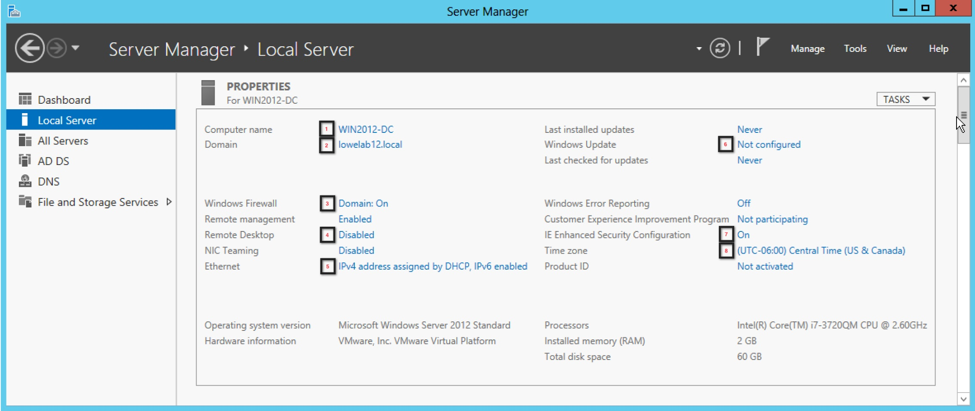
WINDOWS SERVER 2012 R2

Slide 21
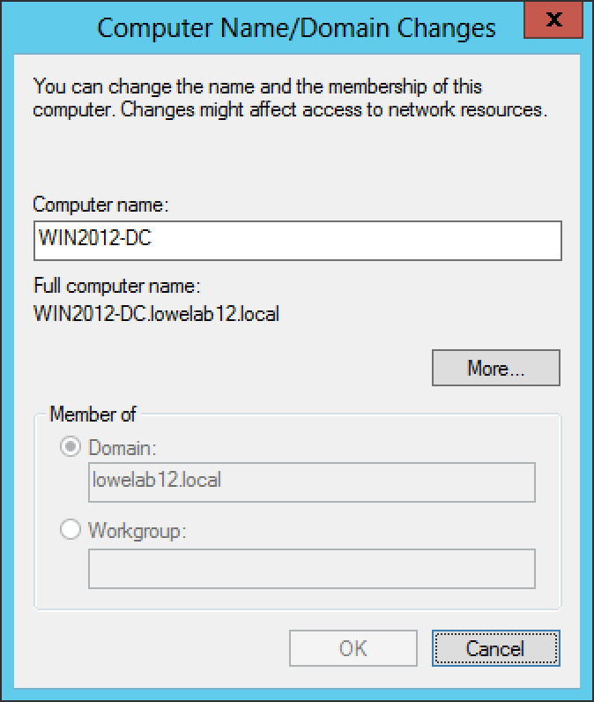
WINDOWS SERVER 2012 R2

Slide 22
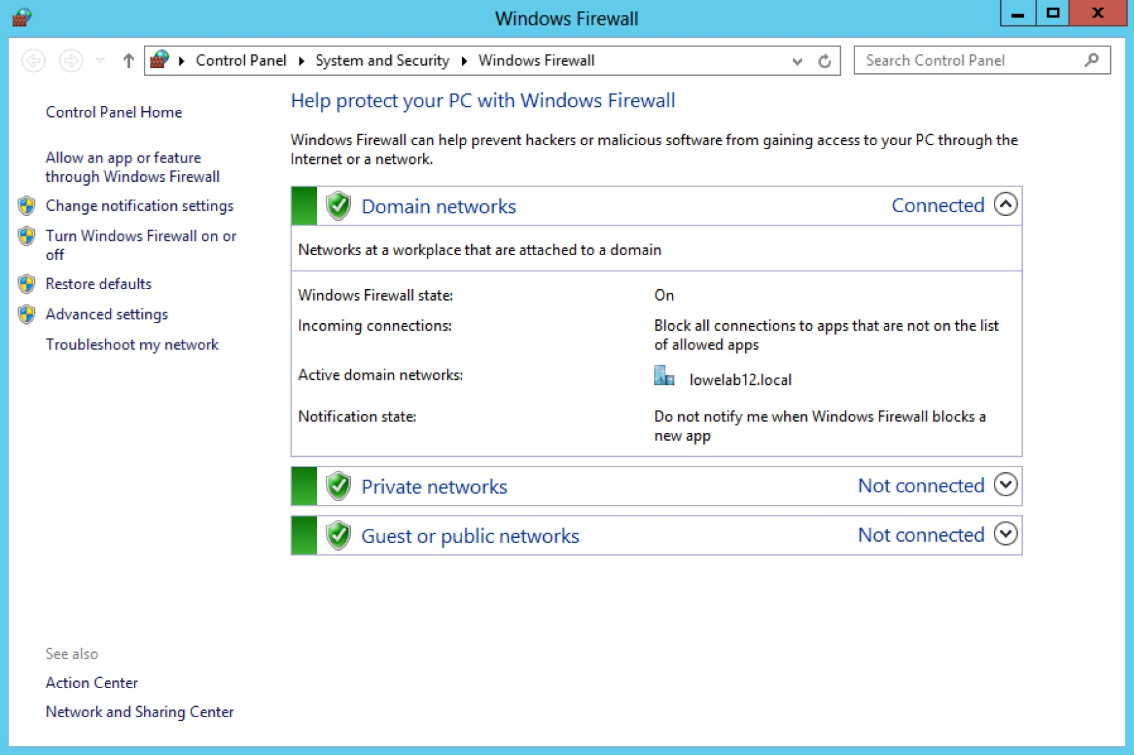
WINDOWS SERVER 2012 R2

Slide 23
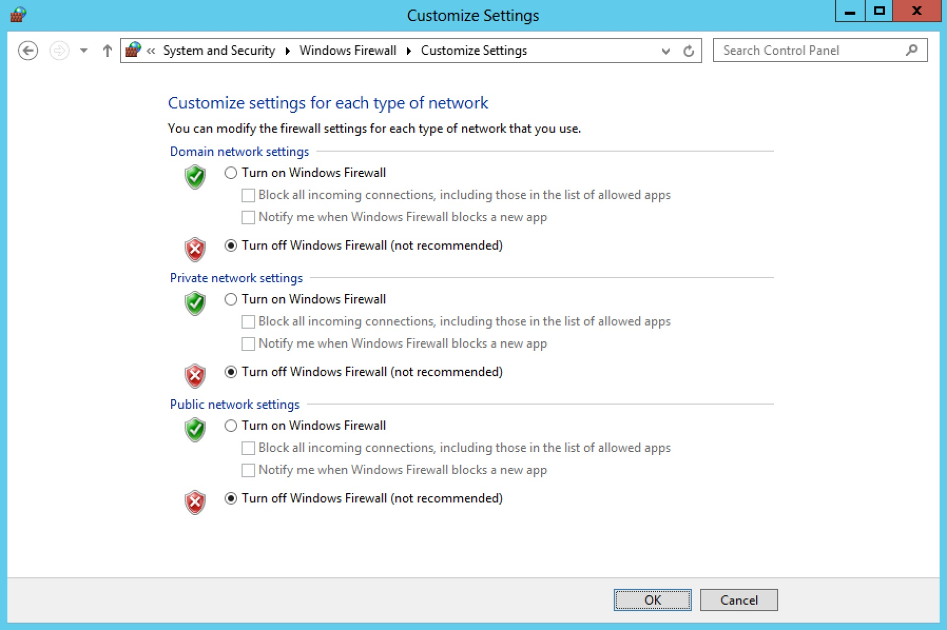
WINDOWS SERVER 2012 R2

Slide 24
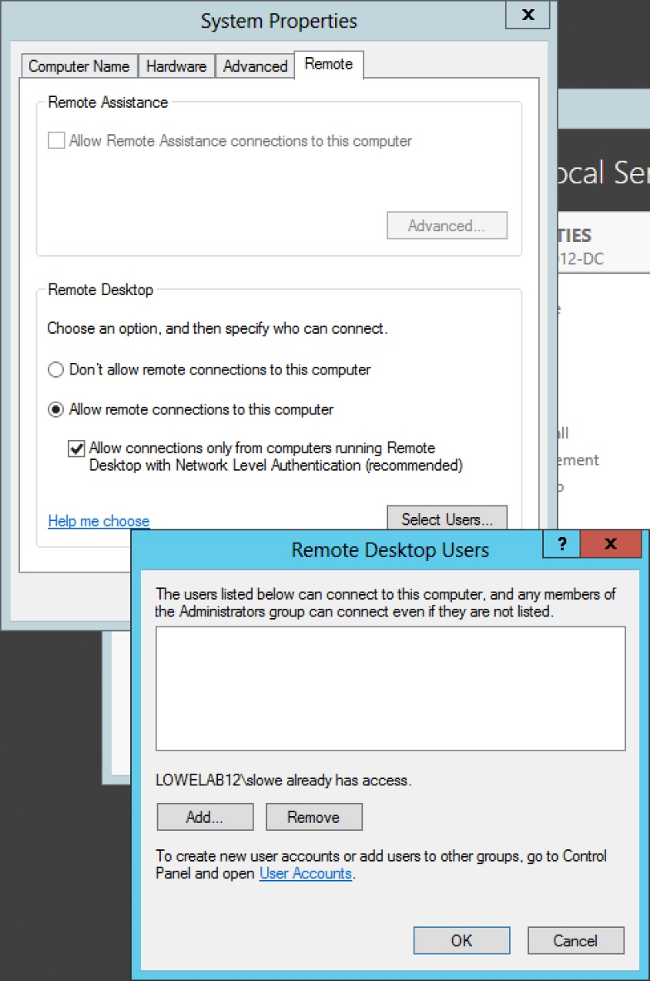
WINDOWS SERVER 2012 R2

Slide 25
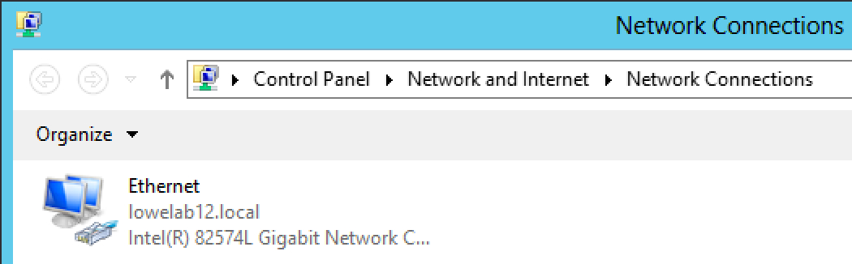
WINDOWS SERVER 2012 R2

Slide 26
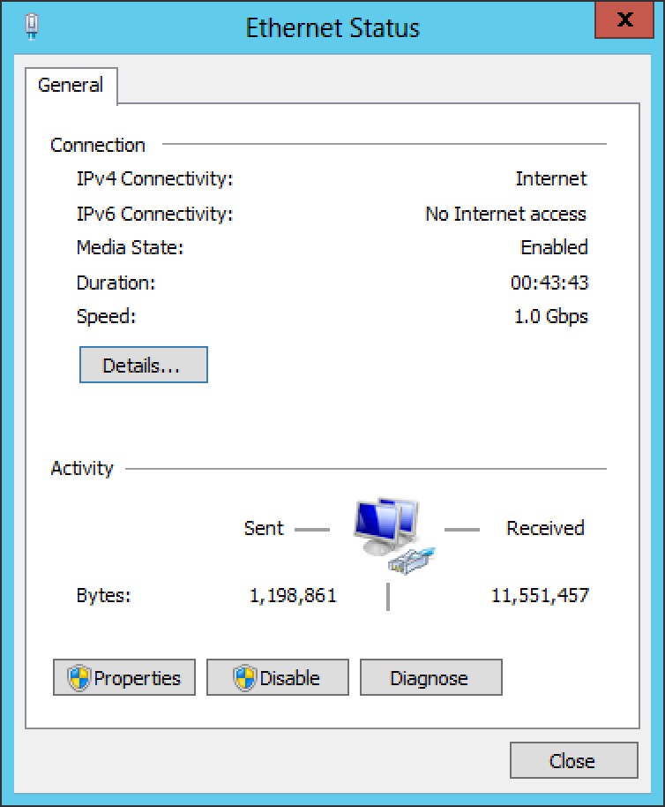
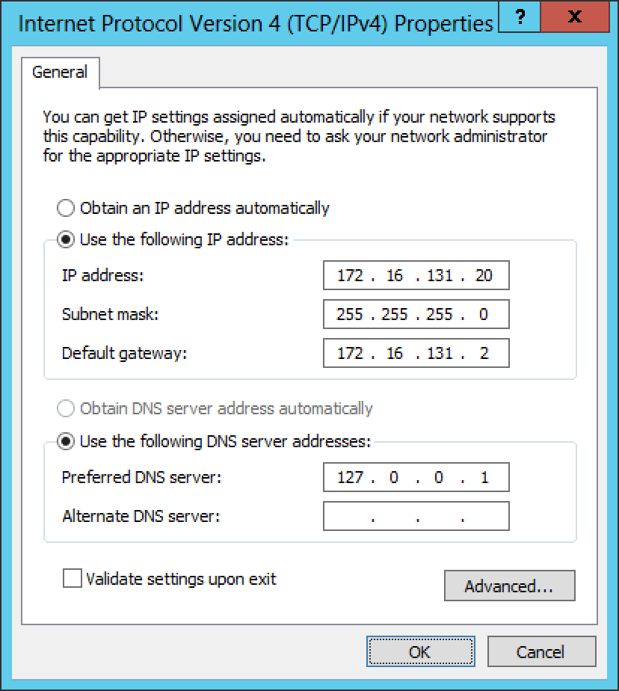
WINDOWS SERVER 2012 R2

Slide 27
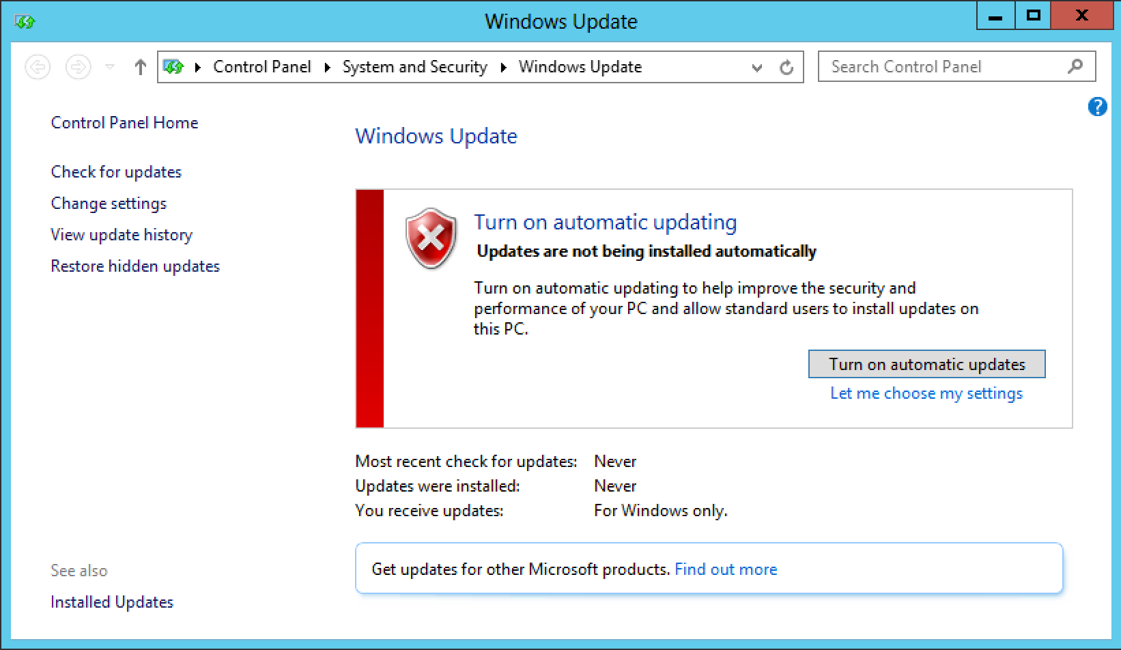
WINDOWS SERVER 2012 R2

Slide 28
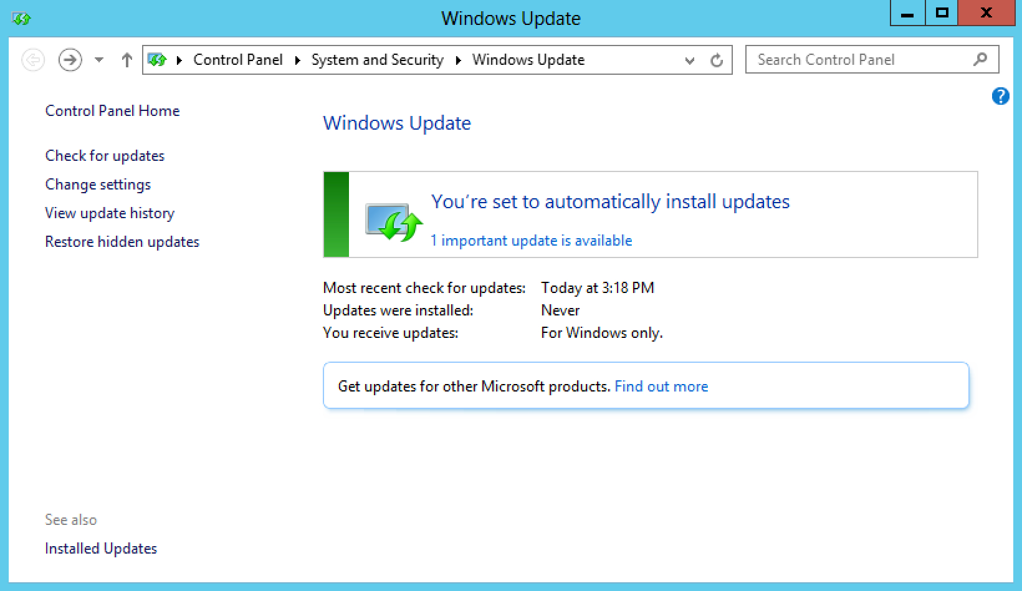
WINDOWS SERVER 2012 R2

Slide 29
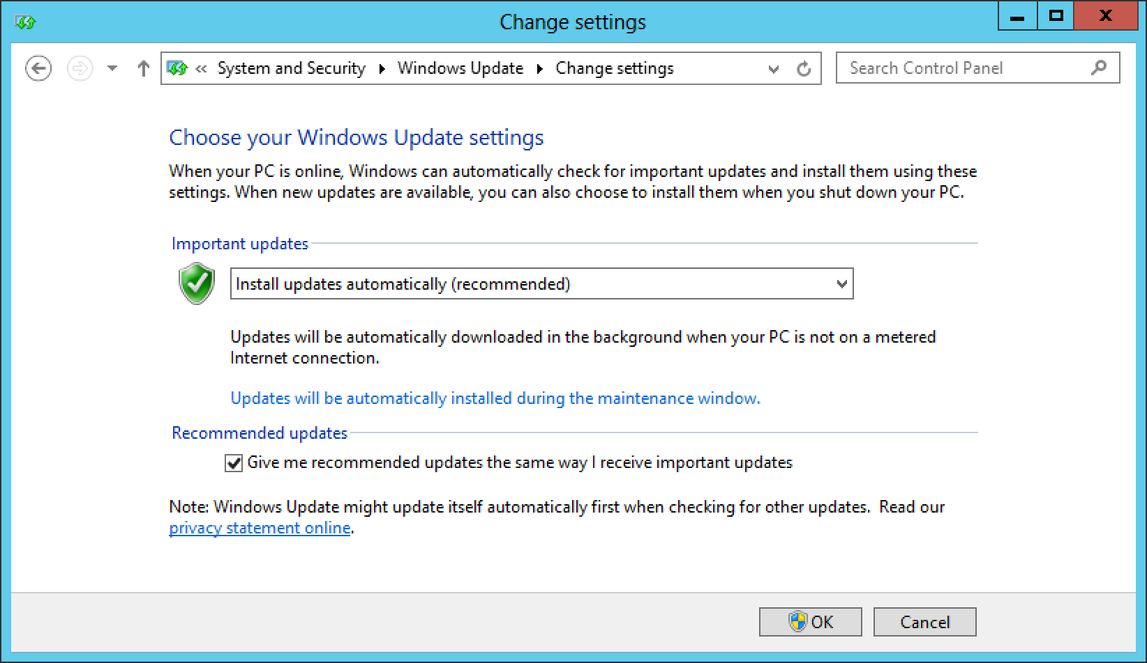
WINDOWS SERVER 2012 R2

Slide 30
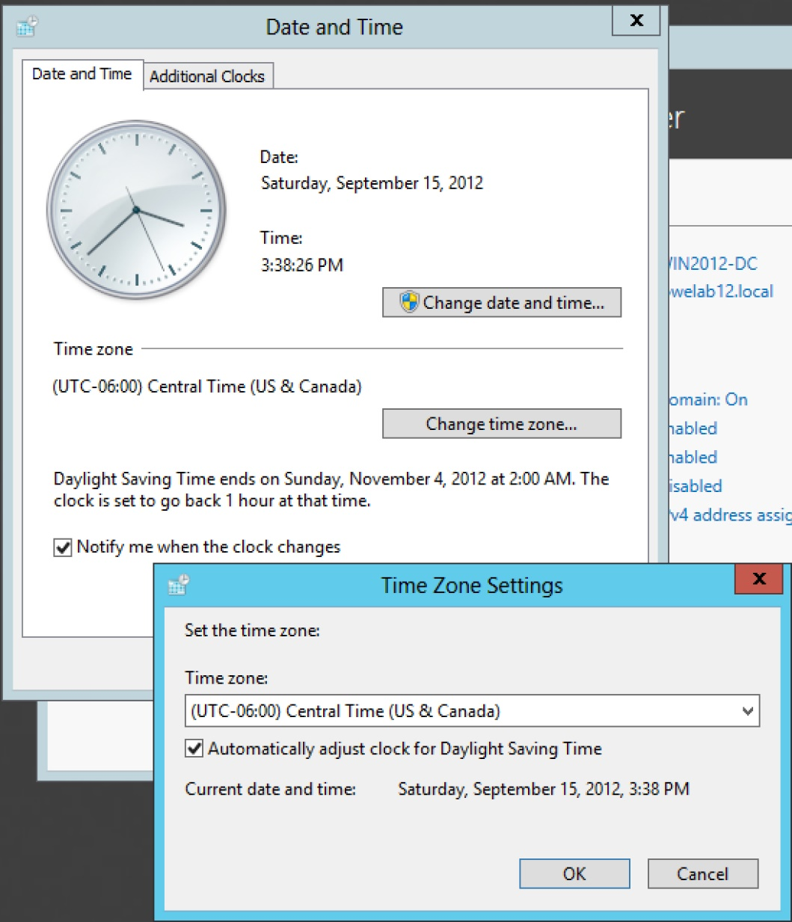
WINDOWS SERVER 2012 R2

Slide 31
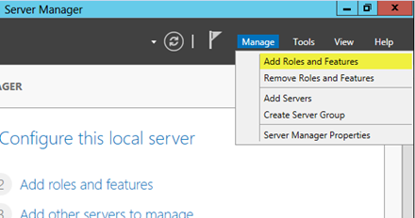
WINDOWS SERVER 2012 R2

Slide 32
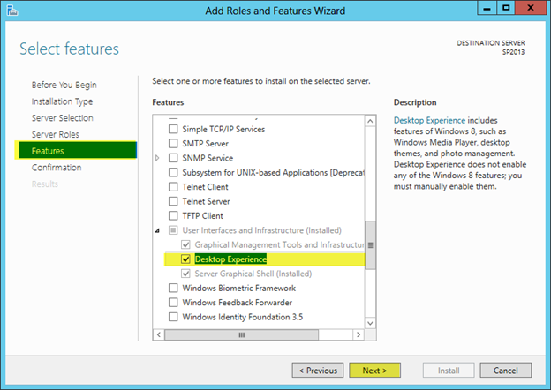
WINDOWS SERVER 2012 R2

Slide 33
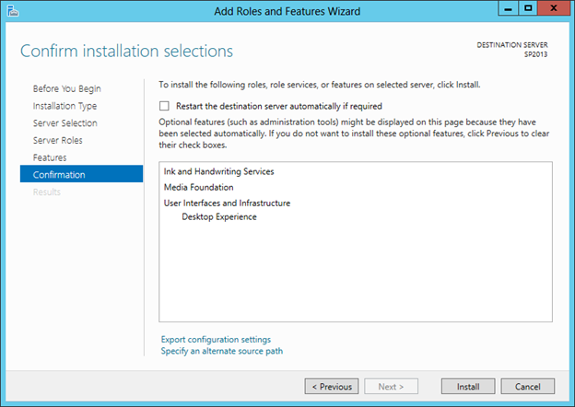
WINDOWS SERVER 2012 R2

Slide 34
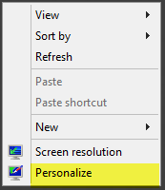
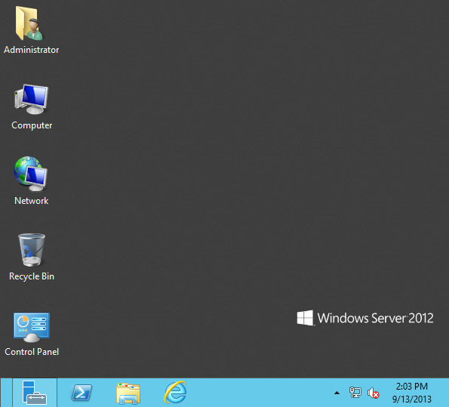
WINDOWS SERVER 2012 R2

Slide 35
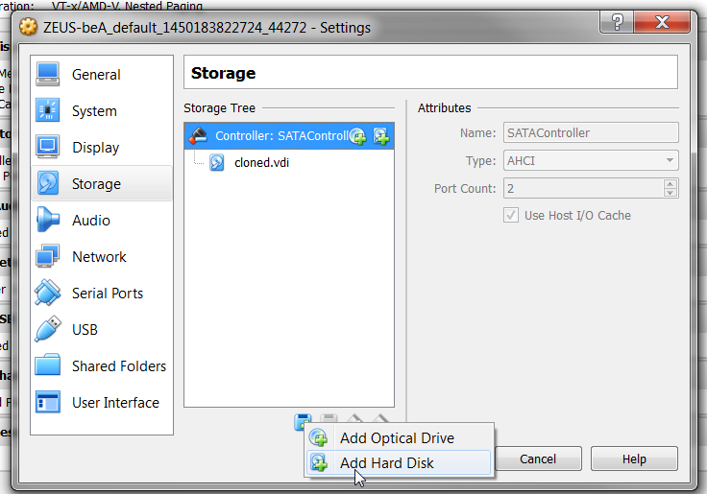
WINDOWS SERVER 2012 R2

Slide 36
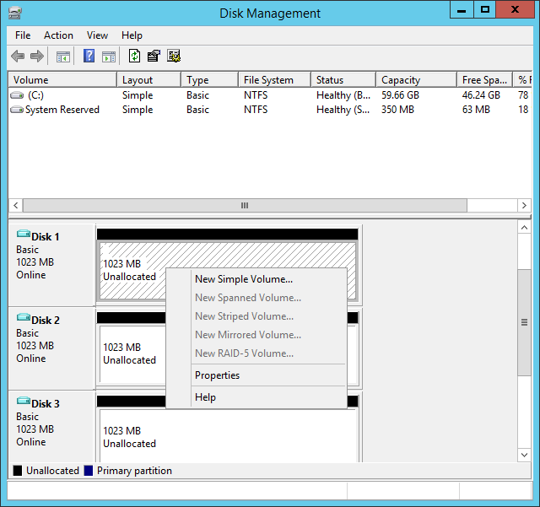
WINDOWS SERVER 2012 R2

Slide 37
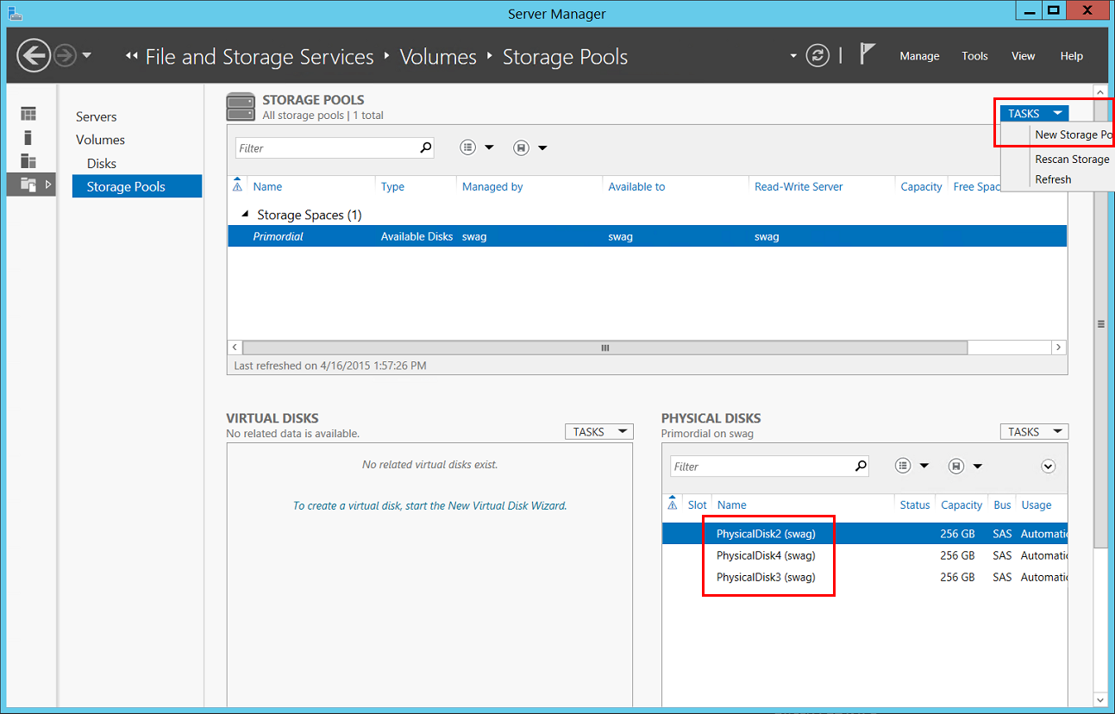
WINDOWS SERVER 2012 R2

Slide 38
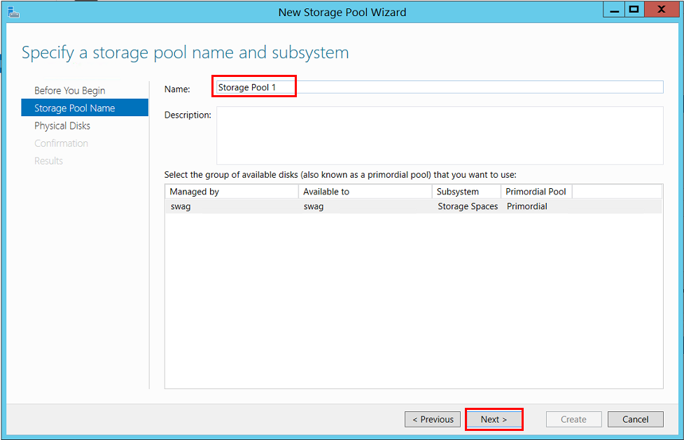
WINDOWS SERVER 2012 R2

Slide 39
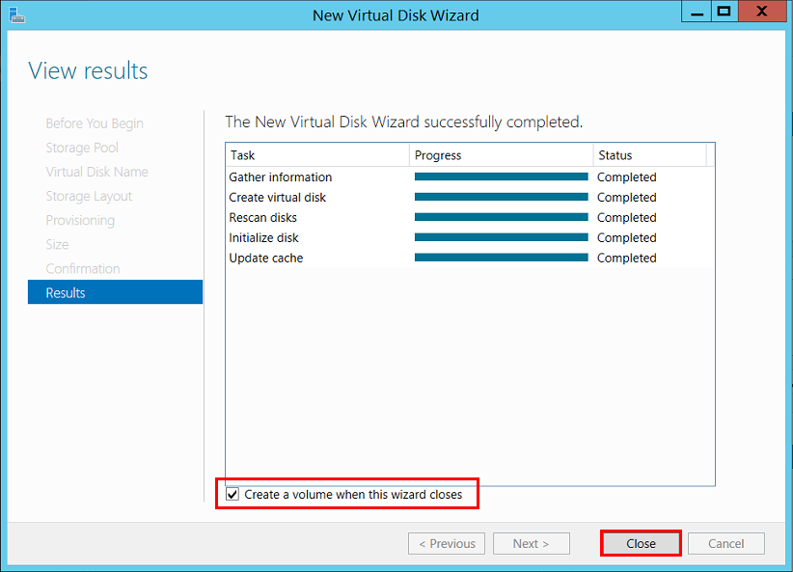
WINDOWS SERVER 2012 R2

